Slide 1

Three-Class Diabetes Status Prediction with Failure-Aware Ensemble Learning and Explainable AI

Slide 2
PROBLEM STATEMENT
Diabetes is a major public-health challenge influenced by multiple demographic, behavioral, and health-related factors.
Identifying No Diabetes, Prediabetes, and Diabetes from population health indicators is challenging because the classes are highly imbalanced, particularly for the prediabetes class.
Conventional machine learning models may achieve high overall accuracy while providing poor recognition of minority classes.
Existing prediction approaches often focus primarily on model performance without sufficiently analyzing model disagreement, failure patterns, explainability, calibration, and population-level surveillance context.
Therefore, there is a need for an integrated analytical framework that combines predictive modeling, failure-aware ensemble analysis, explainable AI, and population-level surveillance analytics.

Slide 3
OBJECTIVES
To perform data preprocessing, exploratory data analysis, statistical analysis, and feature engineering on BRFSS health-indicator data.
To develop and compare multiple machine learning models for three-class diabetes status prediction using comprehensive performance metrics.
To analyze model failures, confidence, disagreement, and error overlap using out-of-fold predictions to identify complementary model behavior.
To develop a Failure-Aware Hybrid model using model predictions and behavior-based meta-features for final three-class classification.
To evaluate the proposed hybrid against individual models, soft voting, and standard stacking using a locked test set.
To integrate SHAP and LIME for interpretable predictions and analyze model calibration and subgroup performance.
To integrate CDC diabetes surveillance analytics with the predictive framework into an interactive dashboard for population-level insights and decision support.

Slide 4
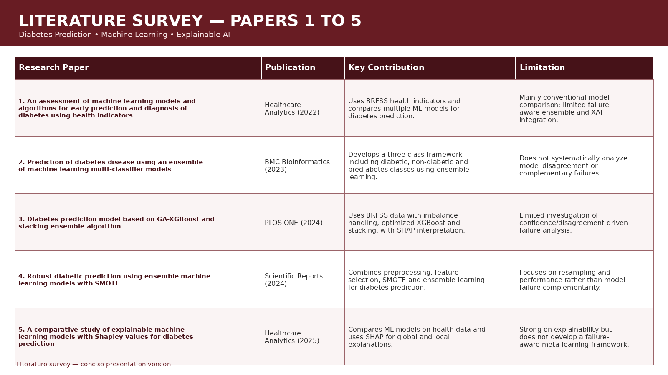
LITERATURE SURVEY — PAPERS 1 TO 5
Research Paper | Publication | Key Contribution | Limitations
Feature-Limited Prediction on the UCI Heart Disease Dataset (2023) | Computers, Materials & Continua | Performs EDA on the UCI dataset, examines feature distributions and missing values, applies feature selection, and compares multiple ML models. | Limited to EDA and feature selection; does not incorporate explainability or a deployment interface.
An Active Learning Machine Technique Based Prediction of Cardiovascular Heart Disease from UCI-Repository Database (2023) | Scientific Reports | Performs preprocessing, EDA, and visualization to examine attribute relationships before applying multiple ML classifiers. | Focuses on classification performance only; lacks explainability (SHAP/LIME) and input validation.
Mixed Machine Learning Approach for Efficient Prediction of Human Heart Disease by Identifying Numerical and Categorical Features (2022) | Applied Sciences – MDPI | Uses combined UCI data (Cleveland, Hungary, Switzerland, VA Long Beach); analyzes numerical/categorical features and compares ML approaches. | Does not include model interpretability or an interactive deployment component for practical use.
Finding the Influential Clinical Traits that Impact on the Diagnosis of Heart Disease Using Statistical and Machine-Learning Techniques (2022) | Scientific Reports | Investigates feature importance using statistical and ML techniques before applying tree-based classifiers on the combined UCI dataset. | Limited to feature-importance analysis; lacks broader model comparison and explainability integration.
The Efficacy of Machine-Learning-Supported Smart System for Heart Disease Prediction (2022) | Healthcare – MDPI | Evaluates Random Forest, Decision Tree, AdaBoost and KNN; compares performance on combined vs. Cleveland-only datasets. | Provides no model explainability or interactive interface for end users.

Slide 5
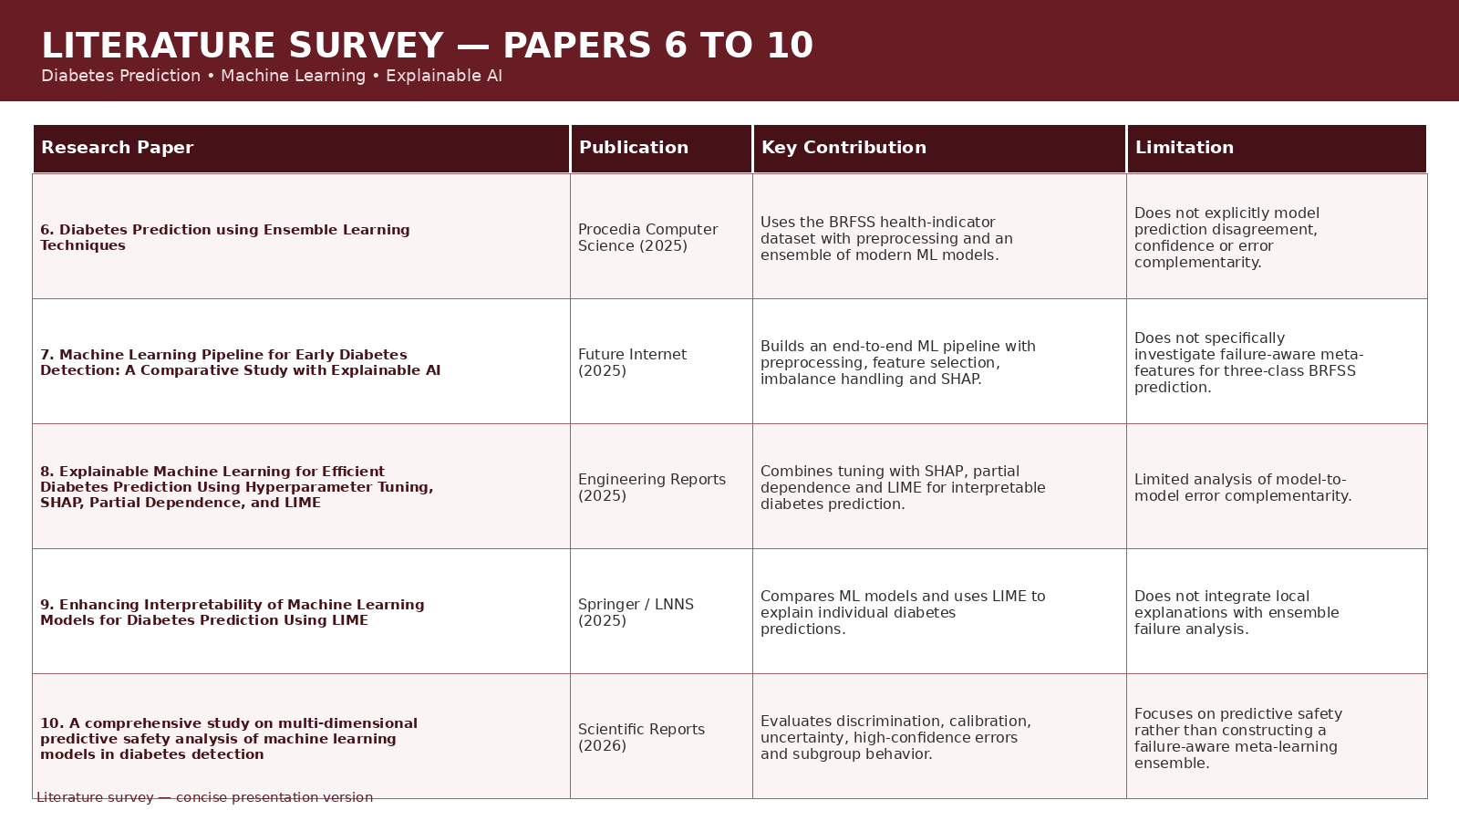

Slide 6
RESEARCH GAP
Severe Minority-Class Challenge: Many diabetes prediction studies emphasize overall accuracy, while the highly imbalanced prediabetes class remains difficult to identify reliably.
Limited Failure Analysis: Existing ensemble approaches often combine models without systematically analyzing where individual models fail and whether other models can correctly classify those failures.
Limited Confidence and Disagreement Modeling: Base-model probability, confidence, entropy, margin, agreement, and disagreement information are not commonly integrated into a unified failure-aware analysis.
Fragmented Explainability: SHAP and LIME are frequently applied to individual models without connecting explanations to model comparison and failure analysis.
Limited Integration of Surveillance Data: Individual-level predictive modeling and population-level diabetes surveillance are often treated separately.
Limited Unified Framework: There is scope for an integrated framework combining predictive analytics, failure analysis, explainability, calibration, subgroup analysis, surveillance analytics, and interactive visualization.

Slide 7
DATASETS
Dataset 1 — BRFSS 2015 Health Indicators
253,680 records
21 original predictor variables
Target: Diabetes_012
Three classes:
  0 — No Diabetes
  1 — Prediabetes
  2 — Diabetes
Class distribution:
  No Diabetes — 84.24%
  Prediabetes — 1.83%
  Diabetes — 13.93%
29 retained features after feature engineering:
  21 original features
  8 engineered features
Dataset 2 — CDC Diabetes Surveillance Data
13,889 records
16 variables
Aggregate population-level surveillance data
Used for:
  temporal analysis
  demographic analysis
  population-level diabetes context
Important: Dataset 2 is used as a surveillance/context dataset, not merged with Dataset 1 and not treated as external validation.

Slide 8
PROPOSED METHODOLOGY
ML Pipeline:
Dataset → Preprocessing → EDA & Statistical Analysis → Feature Engineering → ML Models → Hyperparameter Optimization → OOF Predictions → Failure Analysis → Failure-Aware Hybrid → Model Evaluation → SHAP/LIME → Surveillance Analysis → Interactive Dashboard
Evaluation Metrics:
Accuracy → Precision → Recall → Macro-F1 → Balanced Accuracy → MCC → Confusion Matrix

Slide 9
DEVELOPED DASHBOARD
Diabetes Status Prediction
Model Performance Comparison
SHAP & LIME Explanations
Failure & Disagreement Analysis
CDC Population Surveillance
Interactive Data Visualizations
Flow:
Input → Prediction → Explanation → Model Analysis → Surveillance Insights

Slide 10
KEY INNOVATIONS
Failure-Aware Hybrid Learning – Identifies where individual models fail and uses their complementary behavior to improve decision-making.
Model Confidence & Disagreement – Incorporates confidence, entropy, prediction margins, agreement, and disagreement into hybrid learning.
50-Feature Meta-Learning – Combines outputs and behavioral information from 5 complementary base models.
Balanced Meta-Learner – Uses Balanced Logistic Regression to generate the final three-class prediction.
Error & Complementarity Analysis – Examines model error overlap to understand when one model can compensate for another.
Explainable AI – Integrates SHAP and LIME to interpret predictions.
Individual + Population Analytics – Combines BRFSS individual-level prediction with CDC population-level surveillance.
Unified Interactive Dashboard – Integrates prediction, model intelligence, failure analysis, explainability, and surveillance insights.

Slide 11
RESEARCH CONTRIBUTION & FEASIBILITY
Contributions
Develops an integrated framework for three-class diabetes status prediction under severe class imbalance.
Systematically compares individual models, soft voting, standard stacking, and a failure-aware hybrid.
Investigates whether model confidence and disagreement provide useful information beyond conventional ensemble probabilities.
Integrates explainable AI, calibration, subgroup analysis, and population surveillance analytics.
Provides transparent analysis of both the strengths and limitations of ensemble learning for prediabetes detection.
Technical Feasibility
Implemented using Python and open-source machine learning libraries.
Uses publicly available health and surveillance datasets.
Uses established ML algorithms and explainability techniques.
Does not require specialized hardware for deployment.
Interactive dashboard can be accessed through a web browser.
Complete research pipeline is reproducible using saved preprocessing and model artifacts.

Slide 12
CONCLUSION & FUTURE SCOPE
Conclusion:
Developed an end-to-end three-class diabetes prediction framework using BRFSS health indicators.
Integrated ML, failure-aware hybrid learning, explainable AI, and population surveillance analytics.
Identified severe class imbalance, particularly for prediabetes, as a major challenge.
Demonstrated that complex ensemble models do not always outperform simpler approaches.
Future Scope:
Improve prediabetes minority-class detection using advanced imbalance-aware methods.
Perform external validation and cross-dataset testing.
Improve hybrid model calibration and confidence estimation.
Extend analysis using larger and longitudinal health datasets.

Slide 13
THANK YOU

